Slide 1
Power system fault detection and classification
IBM CLOUD INTERNSHIP PROJECT
Presented By:
1. Aryan Chavan - MET Institute Of Technology - B.Tech Computer Science Engineering

Slide 2
OUTLINE
Problem Statement (Should not include solution)
Proposed System/Solution
System Development Approach (Technology Used)
Algorithm & Deployment
Result (Output Image)
Conclusion
Future Scope
References

Slide 3
Problem Statement
Design a machine learning model to detect and classify different types of faults in a power distribution system. Using electrical measurement data (e.g., voltage and current phasors), the model should be able to distinguish between normal operating conditions and various fault conditions (such as line-to-ground, line-to-line, or three-phase faults). The objective is to enable rapid and accurate fault identification, which is crucial for maintaining power grid stability and reliability.

Slide 4
Proposed Solution
The solution will consist of the following components:
Data Collection:
Gather historical and simulated power system data, including fault types, voltage, current, power load, fault duration, location coordinates, temperature, weather conditions, and component health.
Use data sources like the Kaggle Power System Faults dataset to train the models.
Data Preprocessing:
Clean and preprocess the collected data to handle missing values, outliers, and inconsistencies.
Perform feature engineering to create relevant features that may impact fault occurrence and classification, such as normalized voltage or temperature thresholds.
Machine Learning Algorithm:
Implement classification algorithms including Random Forest Classifier, Batched Tree Ensemble Classifier, and Snap Logistic Regression to predict the type of fault from the input parameters.
Evaluate multiple models automatically using IBM AutoAI to select the best-performing one.
Deployment:
Deploy the trained model using IBM Watsonx.ai Studio, providing a web interface where CSV or JSON input data can be uploaded for prediction.
Ensure the deployed system can return fault classifications with confidence scores in real-time.
Evaluation:
Assess the model’s performance using appropriate classification metrics such as accuracy, precision, recall, and F1-score.
Monitor predictions and fine-tune the model based on new data or user feedback to improve classification performance over time.

Slide 5
System Approach
The "System Approach" section outlines the overall strategy and methodology for developing and implementing the prediction system. Here's a suggested structure for this section:
Cloud Platform: IBM Cloud Lite
Development Tool: IBM Watsonx.ai Studio – AutoAI
Data Input Format: CSV files with features like:
Fault ID
Latitude & Longitude
Voltage (V)
Current (A)
Power Load (MW)
Temperature (°C)
Wind Speed (km/h)
Weather Condition, etc.
Model Selection: AutoAI automatically selects the best model based on accuracy.

Slide 6
Algorithm & Deployment
Algorithm Used:
Random Forest Classifier
Batched Tree Ensemble Classifier
Snap Logistic Regression
Input Data:
Multivariate time-stamped sensor values from power systems.
Training & Evaluation:
IBM AutoAI handled preprocessing, training, and model tuning.
The best-performing model was selected based on accuracy.
Deployment:
The model is deployed and tested using IBM Watsonx.ai Studio.
Predictions are made in real-time using tabular or JSON input formats.

Slide 7
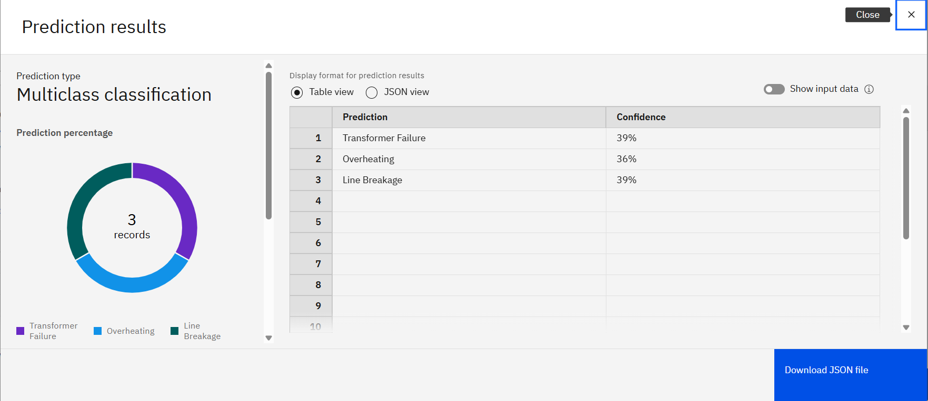
Result
The trained model successfully classifies power system faults into categories like Transformer Failure, Overheating, and Line Breakage.
Example Input: Fault ID: F001, Voltage: 2200V, Current: 250A, Power Load: 50 MW
Prediction Output:
Transformer Failure – 39%
Overheating – 36%
Line Breakage – 39%

Slide 8
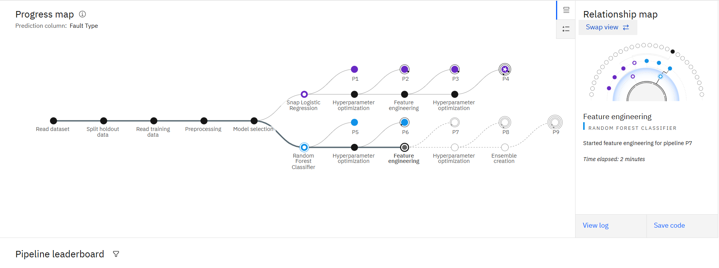
Result
The trained model successfully classifies power system faults into categories like Transformer Failure, Overheating, and Line Breakage.
Example Input: Fault ID: F001, Voltage: 2200V, Current: 250A, Power Load: 50 MW
Prediction Output:
Transformer Failure – 39%
Overheating – 36%
Line Breakage – 39%

Slide 9
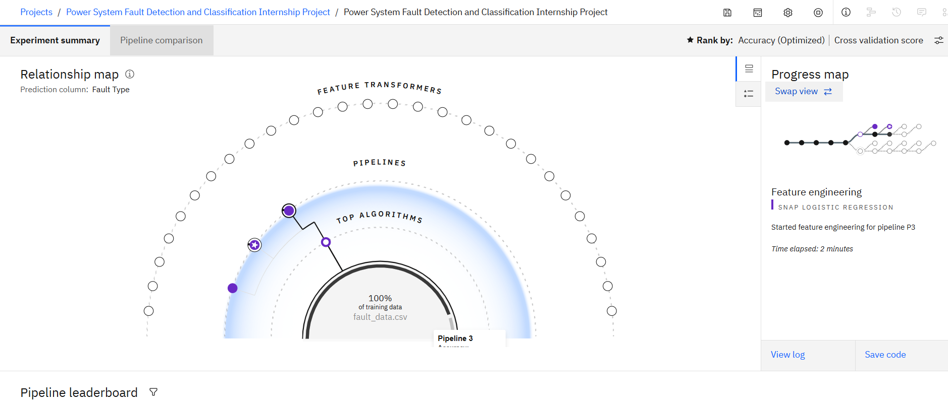
Result
The trained model successfully classifies power sys, Overheating, and Line Breakage.
Example Input: Fault ID: F001, Voltage: 2200V, Current: 250A, Power Load: 50 MW
Prediction Output:
Transformer Failure – 39%
Overheating – 36%
Line Breakage – 39%

Slide 10
Result
The trained model successfully classifies power system faults into categories like Transformer Failure, Overheating, and Line Breakage.
Example Input: Fault ID: F001, Voltage: 2200V, Current: 250A, Power Load: 50 MW
Prediction Output:
Transformer Failure – 39%
Overheating – 36%
Line Breakage – 39%

Slide 11
Conclusion
This project demonstrates an end-to-end AI-powered fault classification system for power grids using IBM Cloud. It automates fault detection with high accuracy and provides real-time fault classification, which helps in:
Minimizing downtime
Improving safety
Enhancing the operational reliability of electrical networks
The IBM AutoAI pipeline significantly reduced development time and provided model explainability and deployment readiness.

Slide 12
Future scope
Integration with IoT-enabled sensors in real-time electrical grids
Extending the model to include predictive maintenance
Adding fault severity prediction
Deploying edge computing for local fault detection in smart grids
Using time-series forecasting for fault anticipation

Slide 13
References
Kaggle Dataset: Power System Faults Dataset
IBM Watson Studio Documentation
AutoAI Model Selection Process
Random Forests and Ensemble Learning Literature

Slide 14
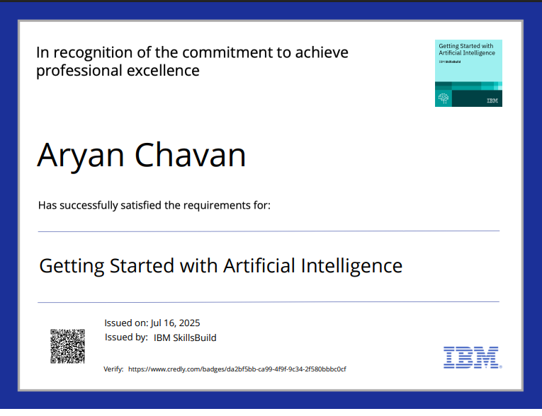
IBM Certifications
Screenshot/ credly certificate( getting started with AI)

Slide 15
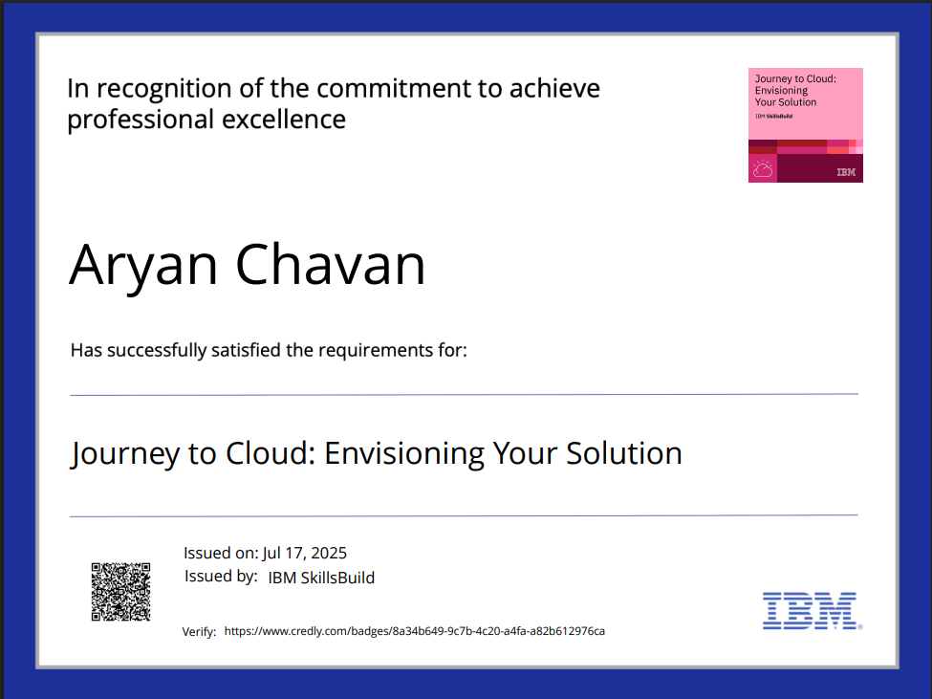
IBM Certifications
Screenshot/ credly certificate( Journey to Cloud)

Slide 16
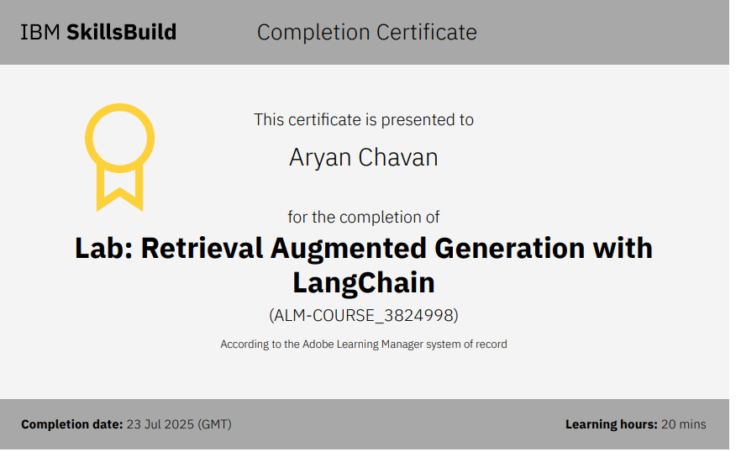
IBM Certifications
Screenshot/ credly certificate( RAG Lab)

Slide 17
THANK YOU

